Slide 1

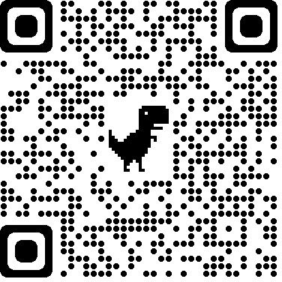
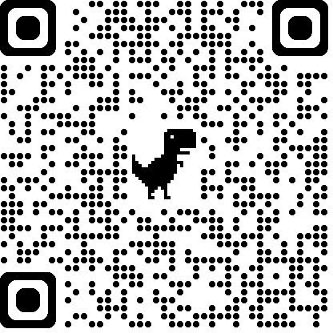

Registration for Parents/Guardians
CREATE A PARENT/GUARDIAN ACCOUNT:
❏ On www.aktivate.com, click Login
❏ Click Create an Account
You only need ONE account, even if you have children in more than one high school and/or junior high
Do not create another account if you have used Register My Athlete/Aktivate in the past
❏ Fill in your personal account information. You will be using the site as a Parent/Guardian.
❏ Click Create Account
❏ Shortly after creating your account, you will receive an email with a 6-digit Verification Code.
Use this code to verify your account when prompted.
Do not close your current tab. You will need to open your email in another tab and find the verification email in your email inbox (it may take a few minutes to appear, so be patient).
REGISTER YOUR STUDENT FOR AN ACTIVITY:
❏ Login with your email address and password
❏ Under the Parents header, click the button labeled Click here to start/complete athlete registrations
❏ Click Start/Complete Registrations under "What would you like to do?"
❏ Click the New Registration + button in the upper right hand corner
❏ Start by clicking the red Select School bar and follow the directions as they appear
❏ Continue following the steps presented in the red bars
❏ Once your registration is complete, you’ll receive a confirmation email from us
Scan to access login page: Scan to access a video guide:
Need Help? For a live chat, click the orange Help button or email support@aktivate.com for assistance.
on the lower left side of the screen

